Slide 1
Industrial Communication µ-Projects
Amitojsingh Arora
Shunnoy Sarkar

Slide 2







Contents
Modbus RTU
HTTP Requests
Modbus TCP
CAN bus
CAN Joystick
IO link MQTT
ESP32 IO link device

Slide 3
Modbus RTU, TCP, HTTP Server
Scope:
RS485-based communication with Modbus temp/humidity sensor using ESP32.
ESP32 operating as:
HTTP Webserver (port 80)
Modbus TCP slave (port 502)
Wi-Fi Access Point
Sensor data displayed by:
REST API HTTP Endpoints (/temperature, /humidity)
Modbus TCP Registers (FC03)
Data visualisation in Node Red.

Slide 4
Modbus RTU with HTTP requests
HTTP over Wifi
(data in JSON)
PC/Smartphone
Modbus Temp/Humidity Sensor
RS-485
ESP 32
(Wifi Access point &Web server)
Node Red
(Uses HTTP request nodes to acquire sensor values)
RS485-TTL converter
Modbus RTU Server
Modbus RTU Client & HTTP Server
HTTP Client

Slide 5
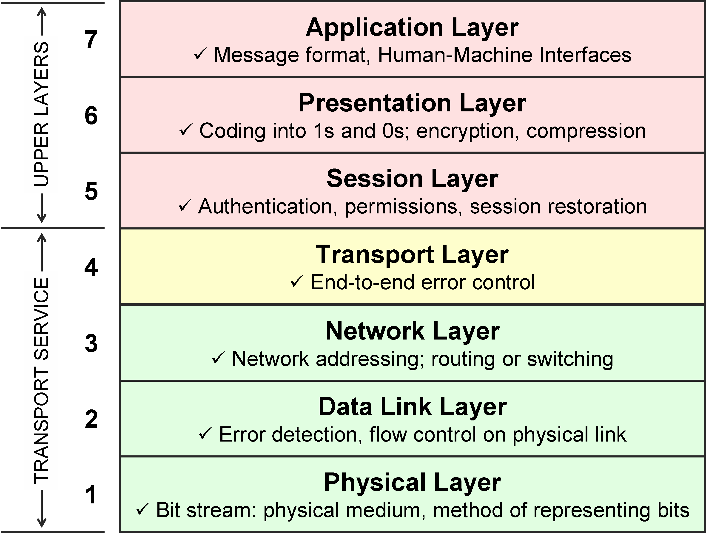
Modbus RTU
Node Red
Modbus RTU(to ESP32)
RS 485 and Temp/Humidity Sensor + ESP32

Slide 6
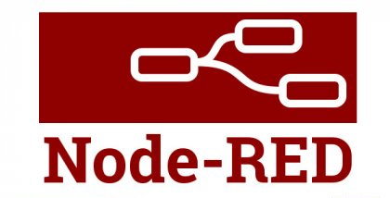
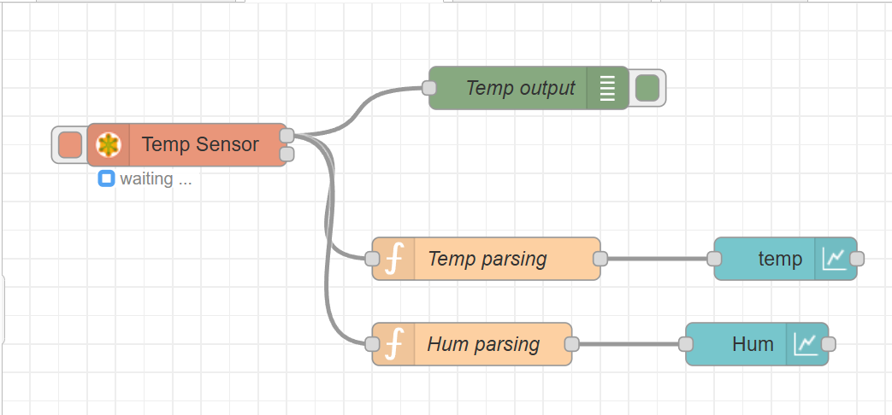
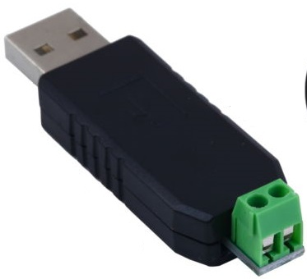
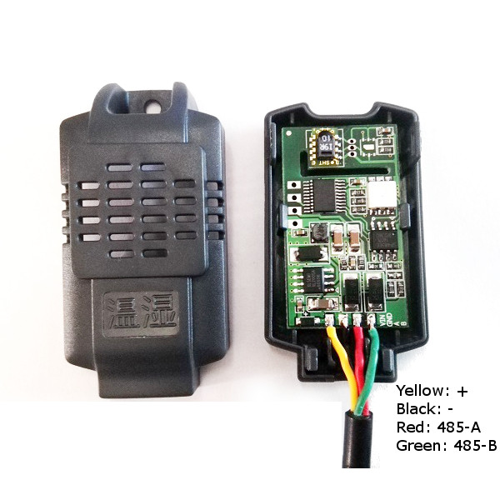
Modbus RTU
USB RS 485
Modbus Temp/ Hum sensor

Slide 7
Modbus RTU, TCP with HTTP requests
Modbus Temp/Humidity Sensor
RS-485
ESP 32
(Wi-Fi Access point &Web server)
HTTP
Node Red
(Acquires data through both HTTP and Modbus TCP)
RS485-TTL converter
Modbus TCP
Modbus RTU Server
Modbus RTU Client & HTTP+Modbus TCP Server
HTTP+ Modbus TCP Client

Slide 8
Modbus TCP
Node Red
TCP (for Modbus TCP and HTTP)
IP header is added
802.11 (Wi-Fi)+ UART (for Modbus RTU)
RS 485

Slide 9
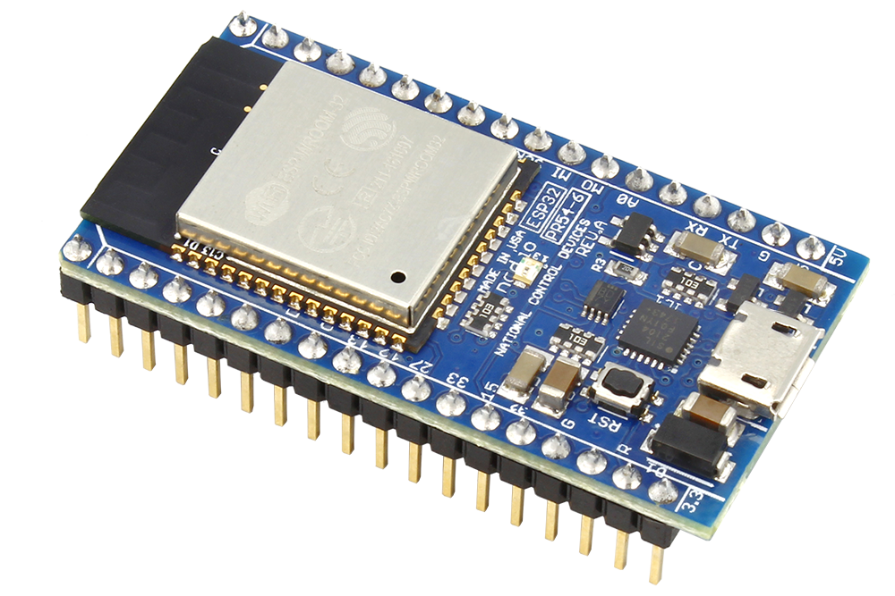
Modbus Communication
PC
Node Red
App visualisation
Modbus RTU Client & HTTP+Modbus TCP Server
ESP32
Modbus TCP Client
502
Modbus TCP Server
80
Modbus RTU client
RS485
RS485
Modbus Temp/ Hum sensor
Modbus RTU Server

Slide 10
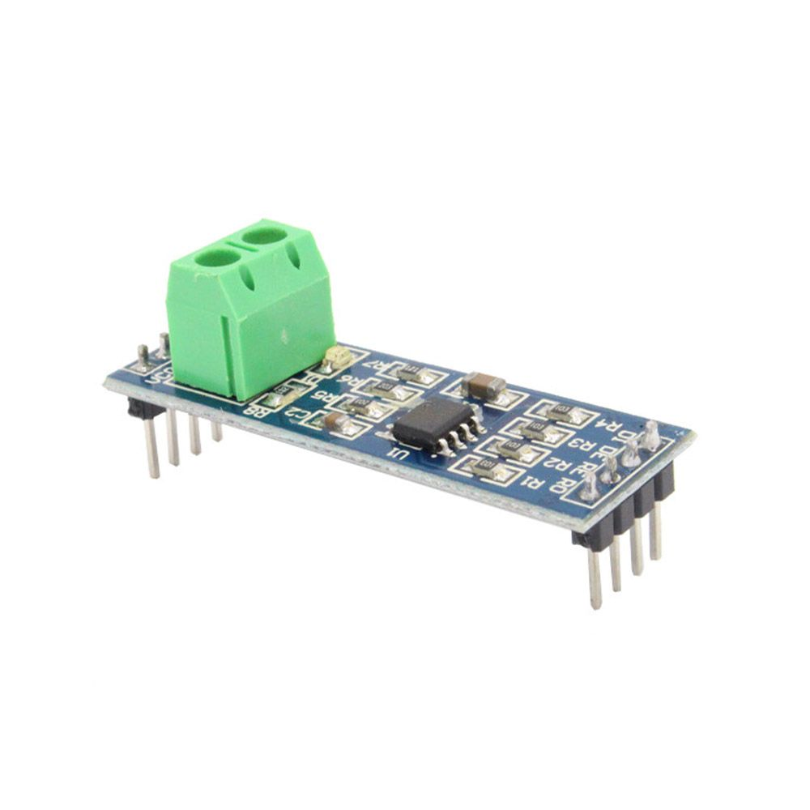

Modbus TCP
RS485 to TTL
ESP 32
Modbus Temp/ Hum sensor

Slide 11
Outcomes
Mini-tasks done:
Published time stamp on NodeRed (Intro to NodeRed)
Controlled an RGB LED over an HTTP server through a Wi-Fi Access Point created by ESP32-s.
Familiarised with Modbus RTU and TCP communication protocols and displaying obtained data over a Webserver via NodeRed.
Used QModMaster for verification of Modbus TCP communication.
Used Wireshark to identify recipient and sender of HTTP requests.

Slide 12
CAN Bus Communication
Scope:
Practical introduction to Controller Area Network (CAN) protocol
Something

Slide 13
CAN Bus Communication
Scope:
Practical introduction to CAN Bus Protocol
Sending and receiving CAN frames between ESP32 and USB CAN analyser (connected to PC).
Adding the application layer (NodeRed) in which CAN data sent by ESP32 is visualised on the dashboard and data sent by serial port by NodeRed would be received by the MCU.
CAN J1939 Protocol Project:
Recognition of button trigger and rotation of a rotary knob via received CAN frames.
Controlling of LEDs on keys and segments with transmission of apt CAN frame data.

Slide 14
CAN Bus
Firmware logic on the ESP32
CAN transport services
CAN protocol: message framing , arbitration, bit stuffing in ESP32 and MCP2515
ESP32 Interface with MCP2515 via SPI

Slide 15
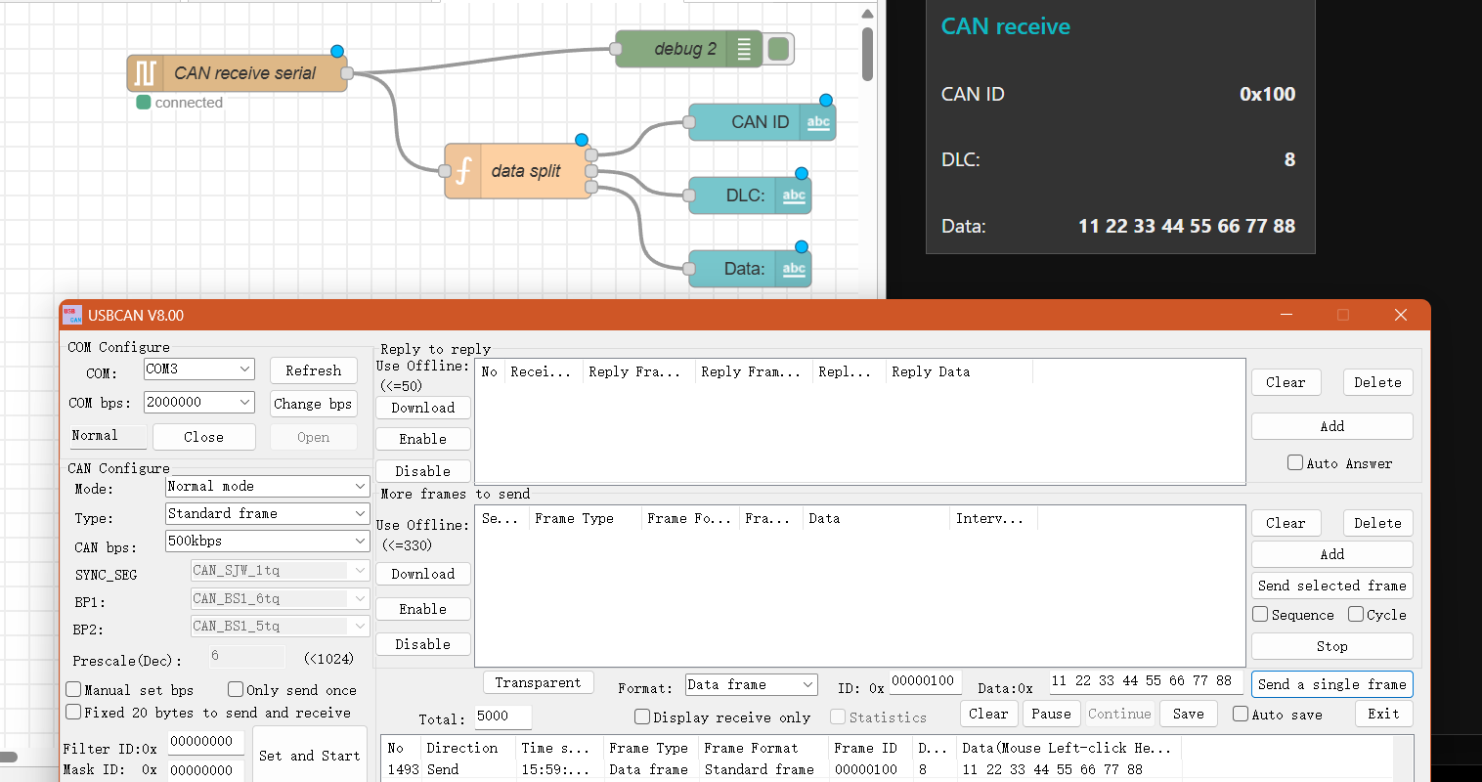
CAN Bus – Send example

Slide 16
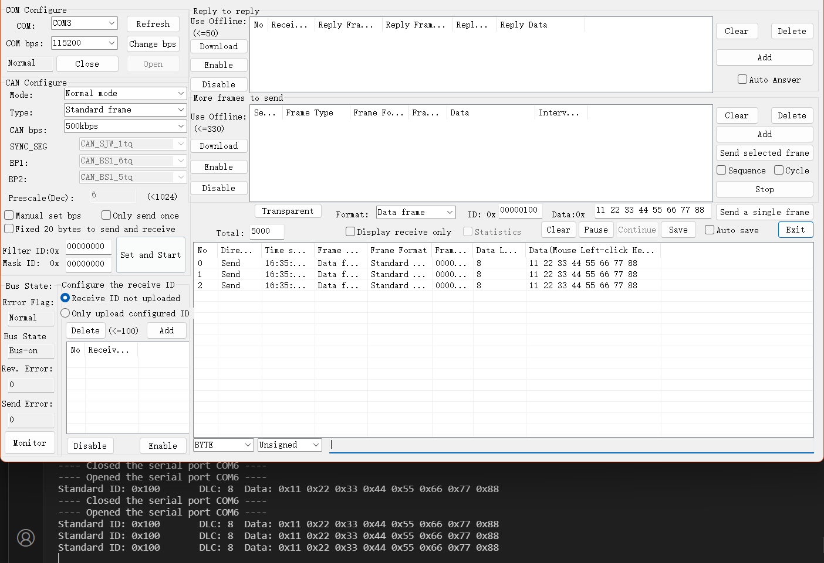
CAN Bus – Receive example

Slide 17
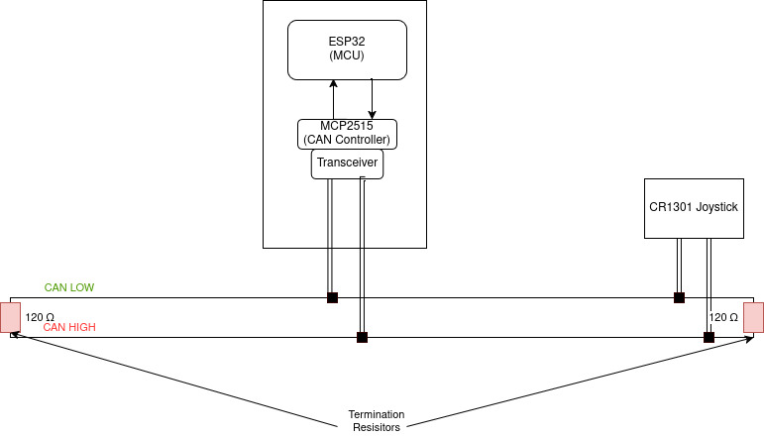
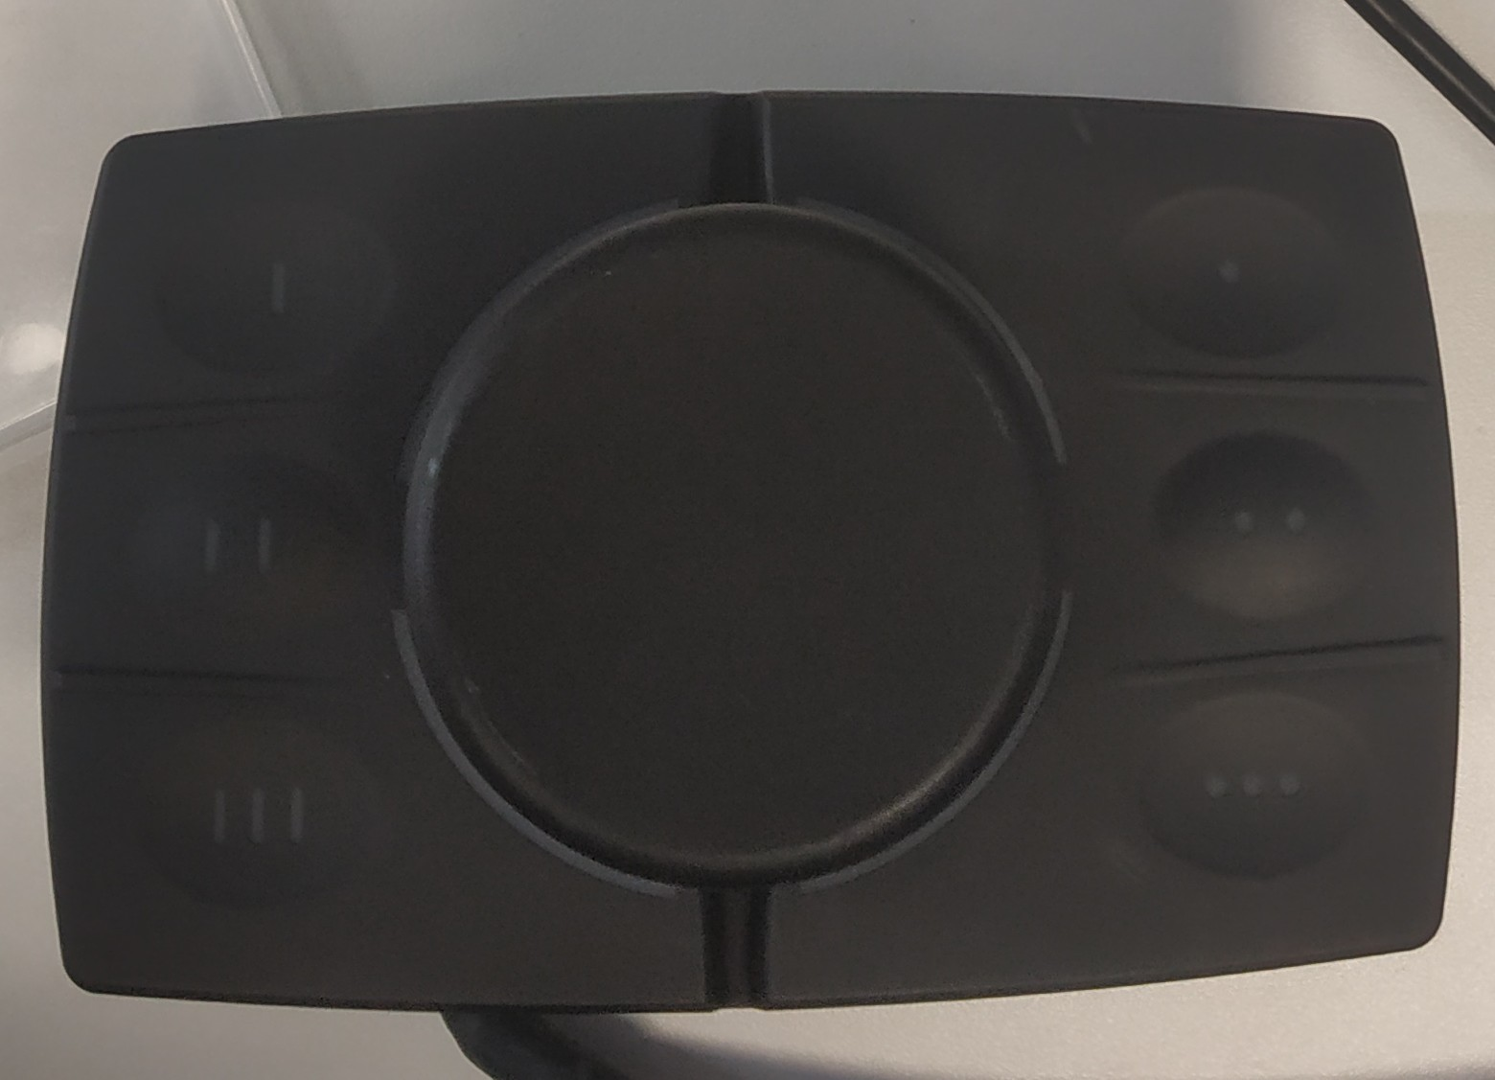
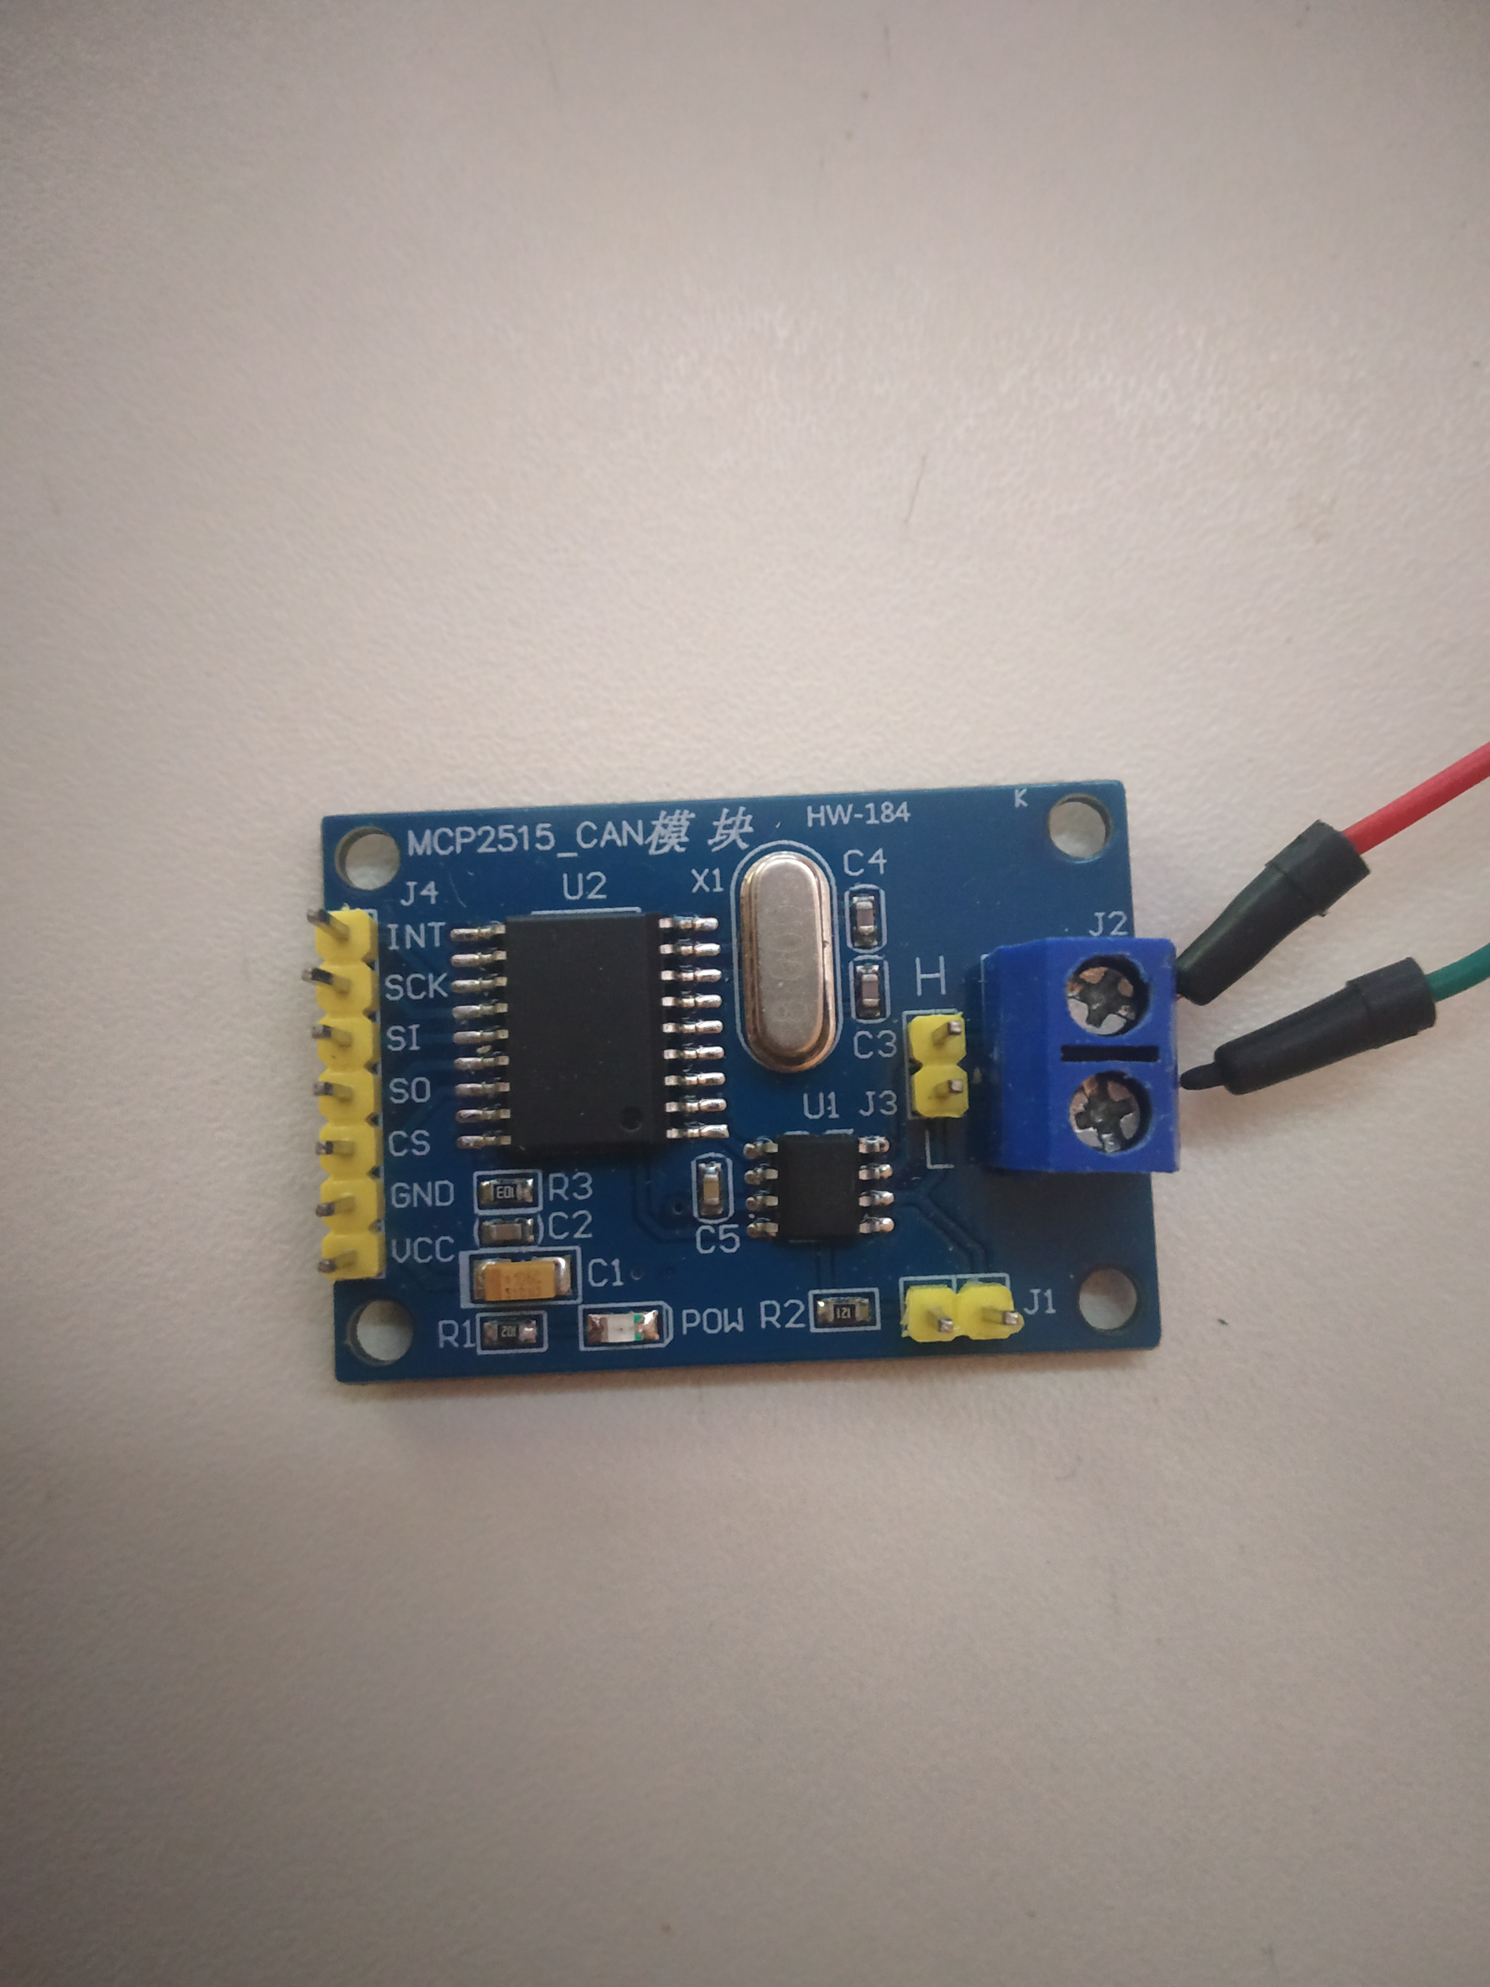
Simplified CAN Bus representation

Slide 18
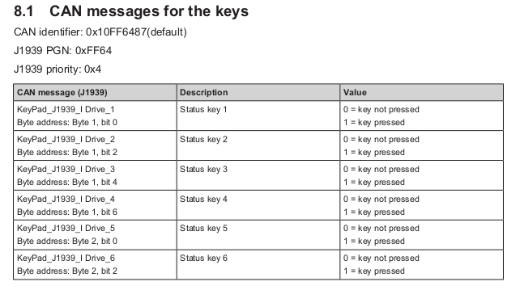
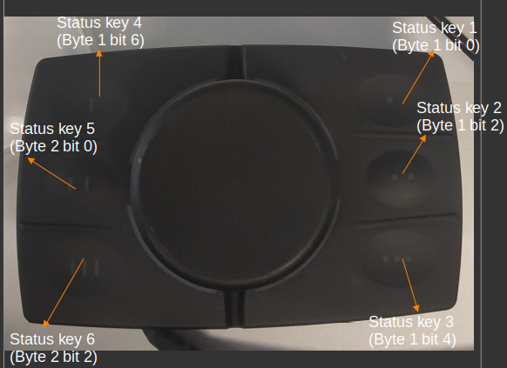
CR1301 Joystick control approach
Identifying and assigning the PGN, priority, src & dest addresses.
Ientifying the keys to their respective labels.

Slide 19
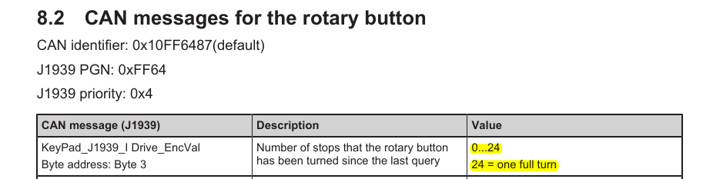
CR1301 Joystick control approach
3. Assigned two states for the entire system:
i) DEFAULT_POSITION_TRACKING : Segment lights up when rotated clockwise to yellow and changes colour ( as per the colour wheel given in lab manual) after every two shifts in encoder position, thus indicating the position of knob by 12 different colours for 24 identifiable stops.

Slide 20
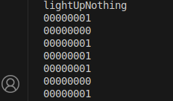
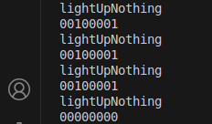
CR1301 Joystick control approach
ii) DETECT_DIRECTION: When the knob is rotated clockwise, the change of byte 3 is (bit 5 remains 0, as mentioned in manual, however bit 0 flips):
However when rotated anticlockwise, we observe:
Bits 0 and 5 are 1.
Thus for these triggers, the segment LEDs blink in the corresponding direction.

Slide 21

Result

Slide 22
ESP32 and IO-Link device

Slide 23
ESP 32 IO link device
Node Red
Modbus RTU
RS 485

Slide 24
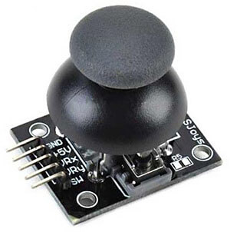
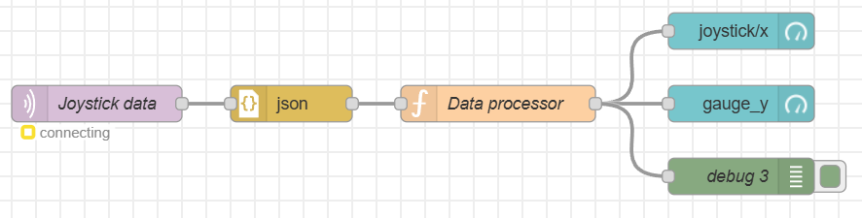
ESP 32 IO link device

Slide 25
FH Aachen Fachbereich xxx Name Studierende(r) o. Seminar xxx Straße Nr. PLZ Ort

